Slide 1

Crisis and Sustainability:
Data-Driven Analysis of 2008
Fajri Ilham Mughni
Updated on 26th January, 2025

Slide 2
Background

Slide 3


Fajri Ilham Mughni
Education
What do I do:
Data Science Student @ DBB Batch 29
Geological Eng. Graduate @ ITB 2018
Subsurface Data Management, Jr. Consultant
at Husky-CNOOC Madura Ltd. (2024 – present)
LinkedIn:
Fajri Ilham Mughni
My writing:
Medium

Slide 4

What I Have Learned in the Bootcamp
Data Cleaning and Manipulation with Python
Web Scrapping from Traveloka Website
Cleaned data across dataset variations.
Analyzed and handled missing values for machine learning and exploratory analysis.
Applied label, mean, and one-hot encoding techniques.
Skilled in storing API data into staging for further processing.
Proficient in web scraping with BeautifulSoup to extract web page information.
The Url to project
The Url to project

Slide 5
Outline :
Purpose Statement
Tell Your Story
Conclusion

Slide 6
What are we talking about

Slide 7
Identify if there are clustering patterns in academic journal publications, influenced by research quality, institutional affiliation, and/or economic factors, that address the challenges posed by the 2008 economic crisis
Objective :

Slide 8
Present data
All scripts, data, and other technical part of the project can be accessed in this link

Slide 9
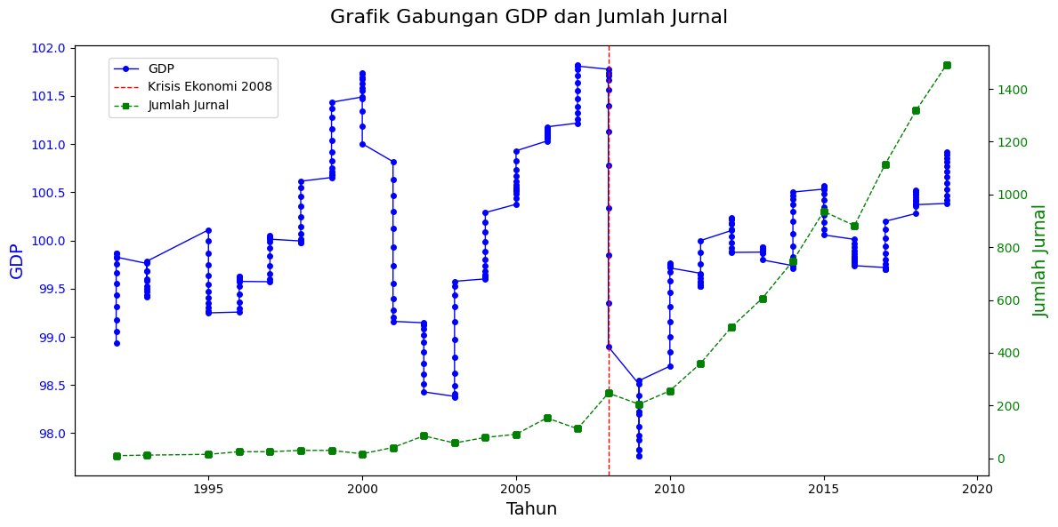
Tren
GDP was Decreased
Publication was increased
Notes:
PDB/GDP dihitung dalam satuan miliar dolar AS dengan menggunakan harga konstan tahun 2012

Slide 10


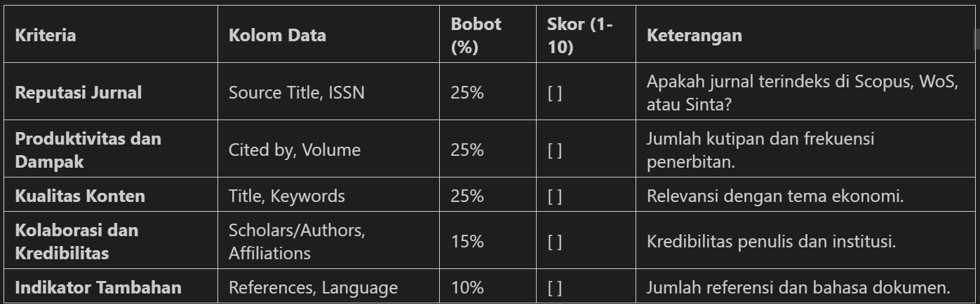
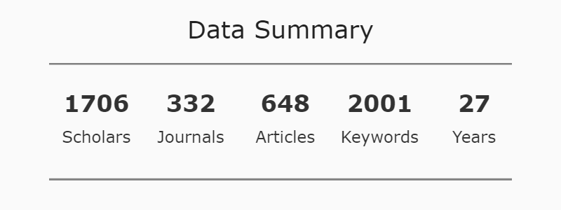
Processing the Data
Scraping data dari website SINTA, CLARIVATE, ELSEVIER untuk menambah data yang kurang, melakukan pembersihan data lanjutan,
Perform data cleaning in the dataframe (null data, duplicated, and missing value actions), separate unique values into different rows, then perform a group by operation to minimize misinterpretation during data processing, scrape data from the Publisher Website. Weight and encode label data that falls under the weighting criteria to be processed into 4 final score clusters using machine learning algorithms (GMM, K-Means, etc.). Search for insights and visualize the clustering results to present the findings. No recommendation actions in this project yet.

Slide 11
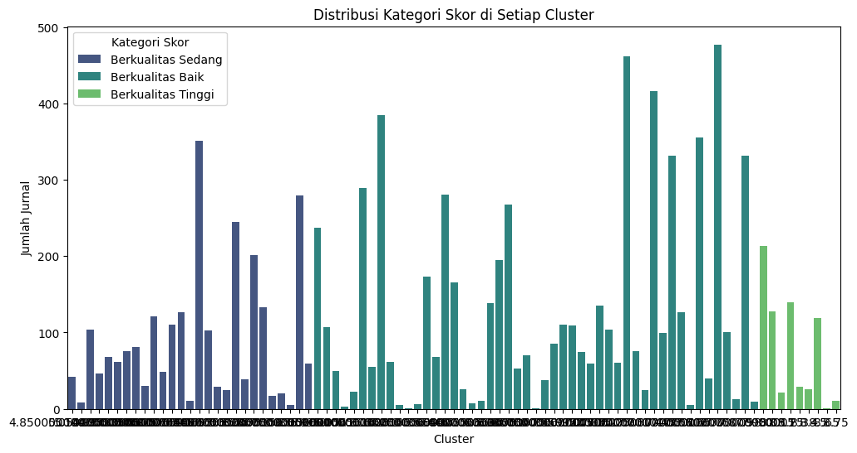
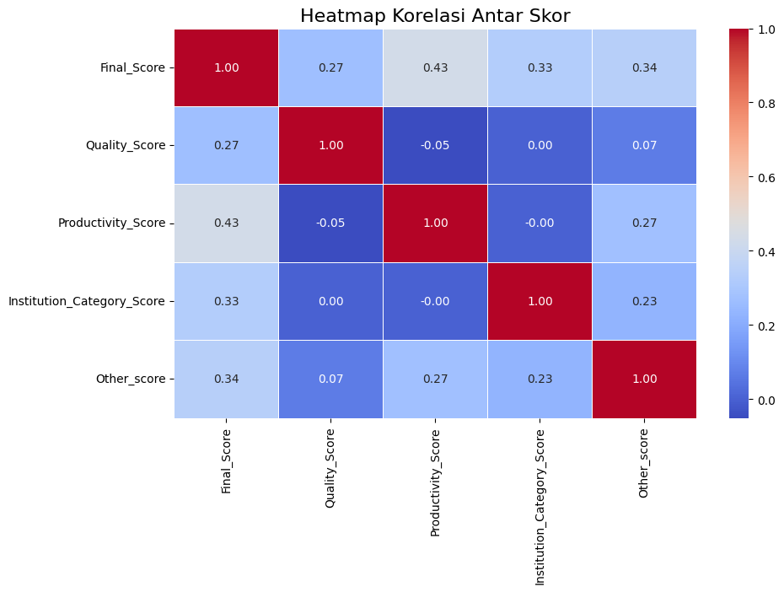
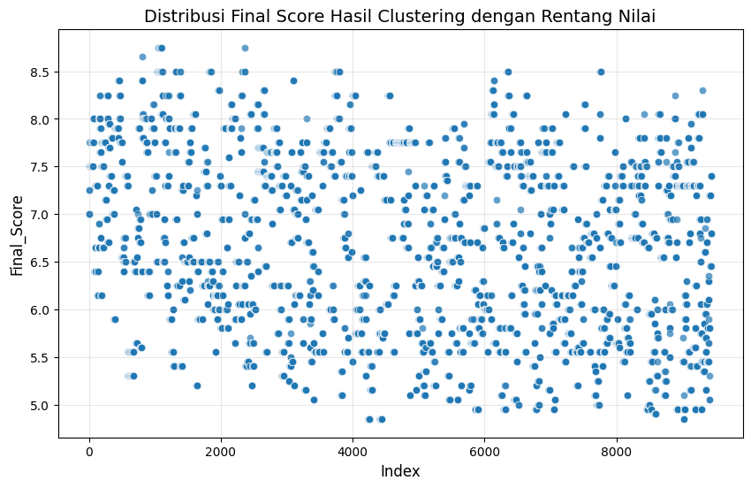
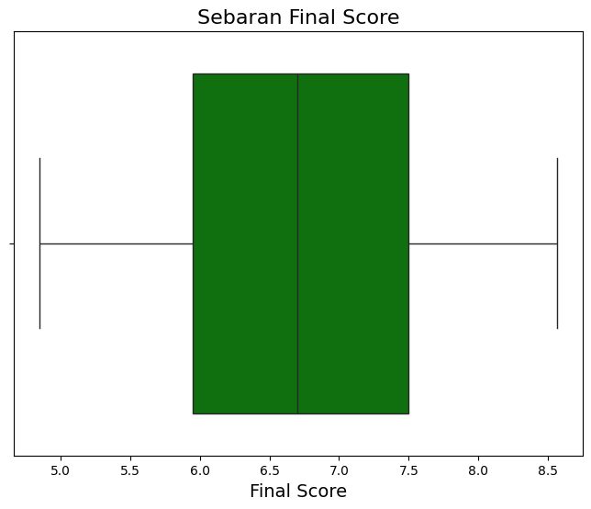
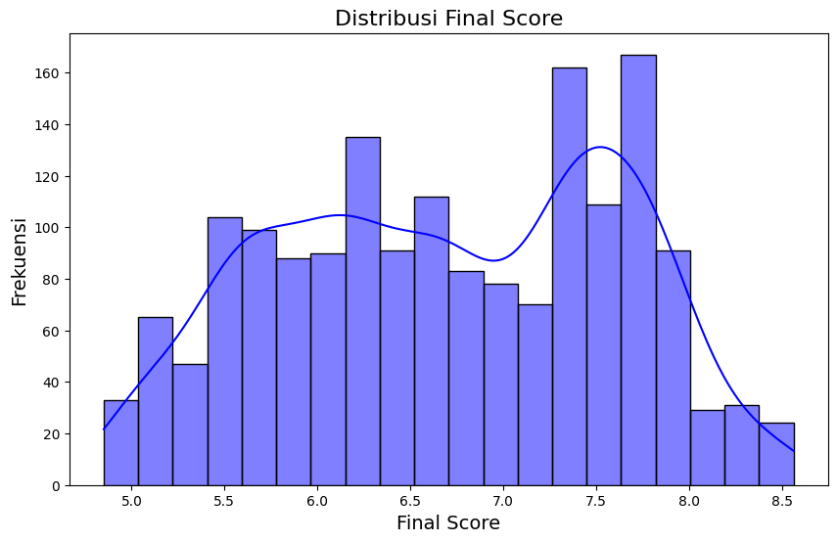
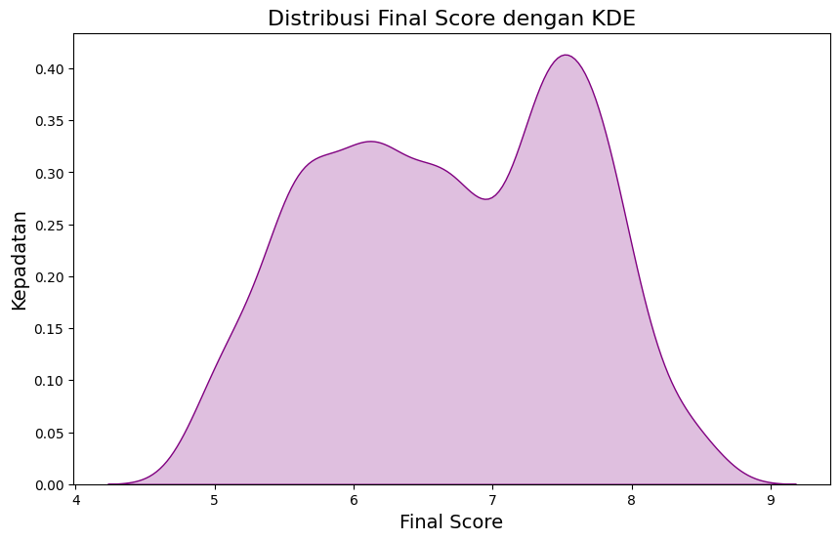
Final Clustering Score
8.0-10.0: High-quality journals are highly recommended.
6.0-7.9: Good quality journals are fairly recommended.
4.0-5.9: Medium-quality journals require further evaluation.
<4.0: Low-quality journals are not recommended.
Good Quality:
1155
Medium Quality:
444
High Quality:
109

Slide 12
Research Quality

Slide 13
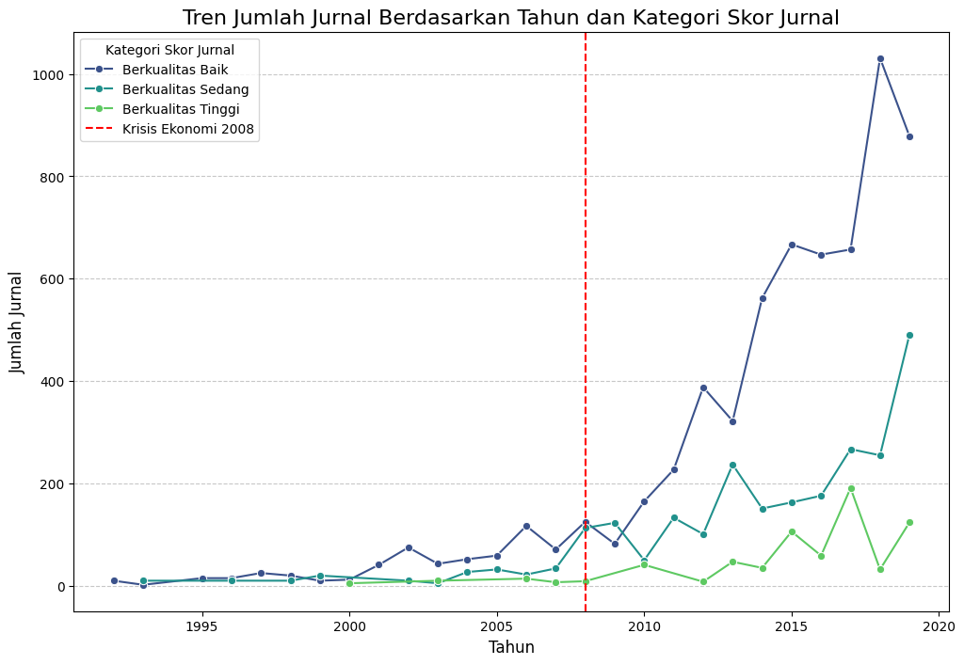
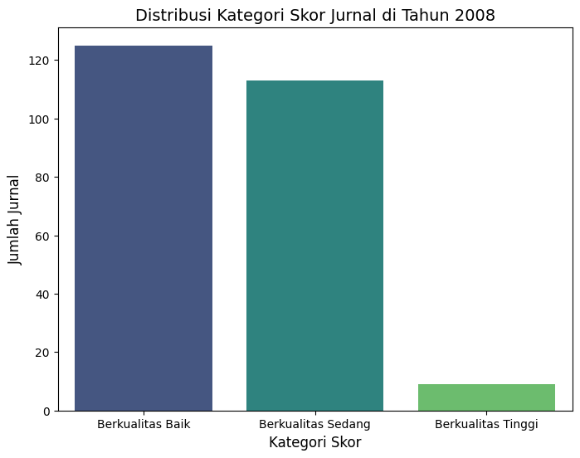
Research Quality
High-quality journals emerged in 2000, reached their lowest point, then stabilized until a rise in 2008.
Medium-quality journals ranked second, with an increasing and fluctuating trend starting in 2008.
Good-quality journals had the highest number, peaked before 2008, then declined but later increased.
Notes:
PDB/GDP dihitung dalam satuan miliar dolar AS dengan menggunakan harga konstan tahun 2012

Slide 14
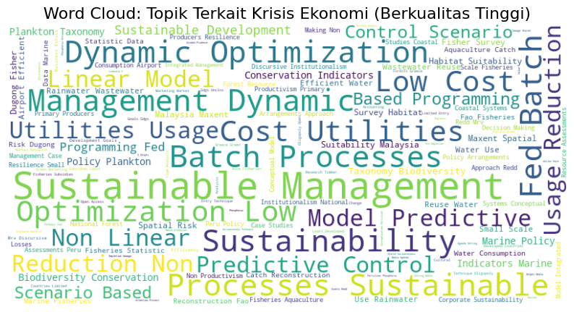
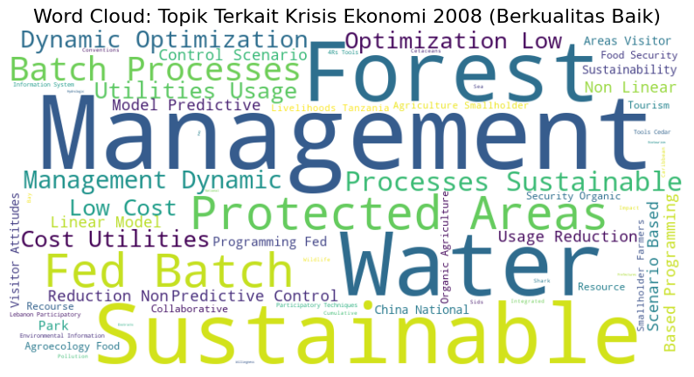
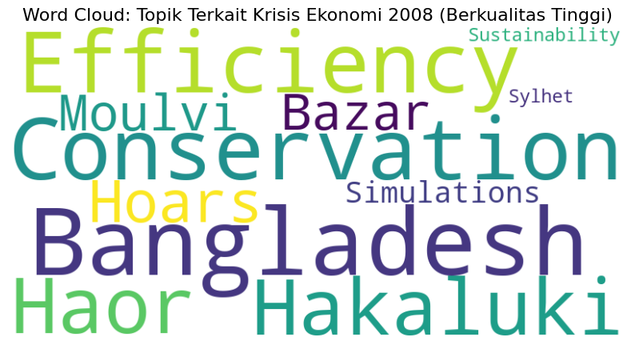
Word Cloud on Research Quality in 2008
Good Quality Journal Keywords
High Quality Journal Keywords

Slide 15
Institution Affiliations

Slide 16
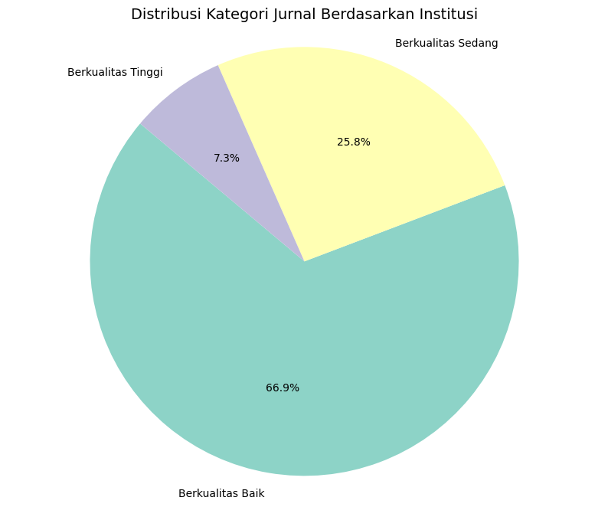
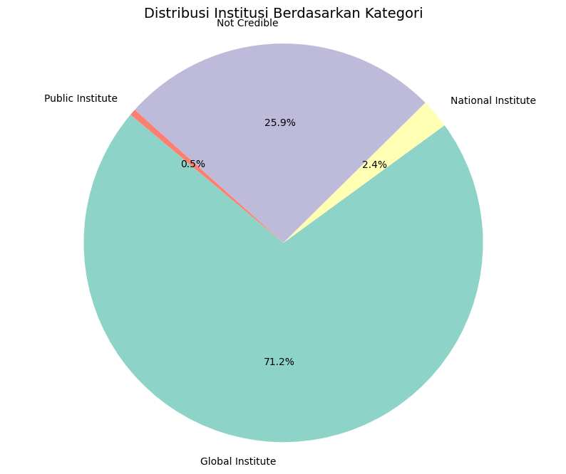
Affiliations
High-quality journals are the top in sustainable publication data management.
Global institutions rank first in the distribution of this data.
These two factors are significant for economic development after the 2008 crisis. Additionally, the continuous improvement of journal quality provides more opportunities for the economy and publications to grow and contribute to the global community.
Notes:
PDB/GDP dihitung dalam satuan miliar dolar AS dengan menggunakan harga konstan tahun 2012

Slide 17
Economic Factors

Slide 18
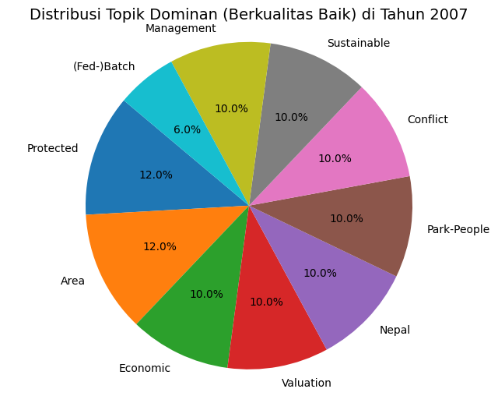
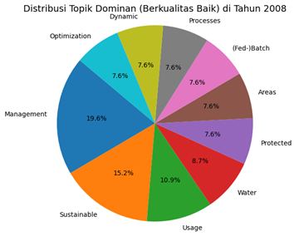
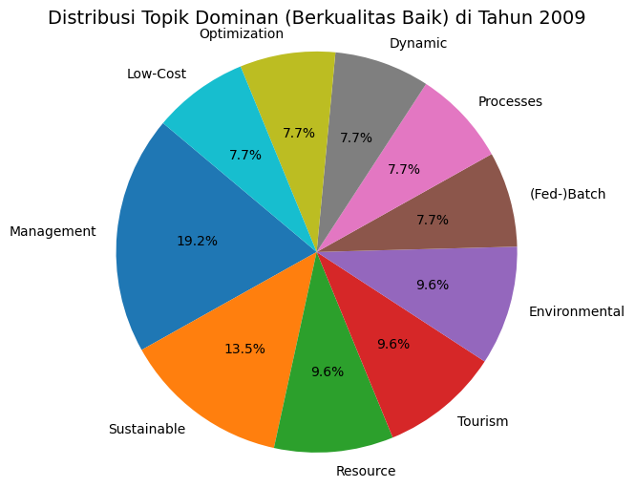
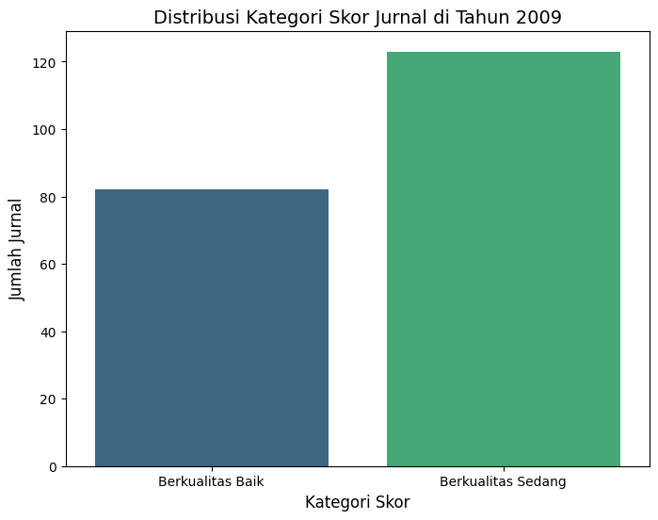
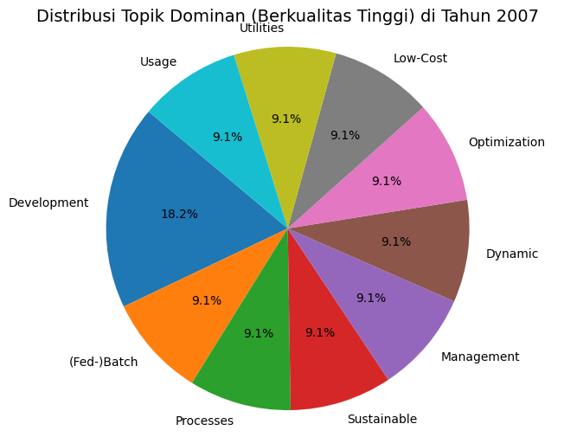
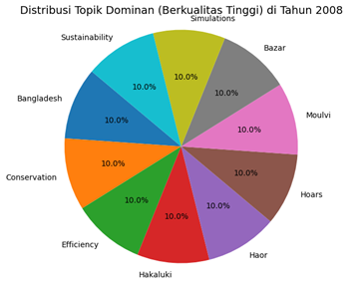
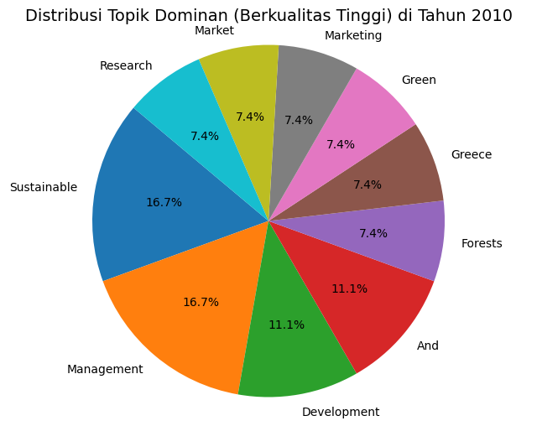
Economic Factors
The relationship between publication keywords and economic factors during the 2008 economic crisis reflects how research topics shifted in response to the market collapse, with increasing focus on financial instability, the impact of the recession, and recovery strategies.
Notes:
PDB/GDP dihitung dalam satuan miliar dolar AS dengan menggunakan harga konstan tahun 2012

Slide 19
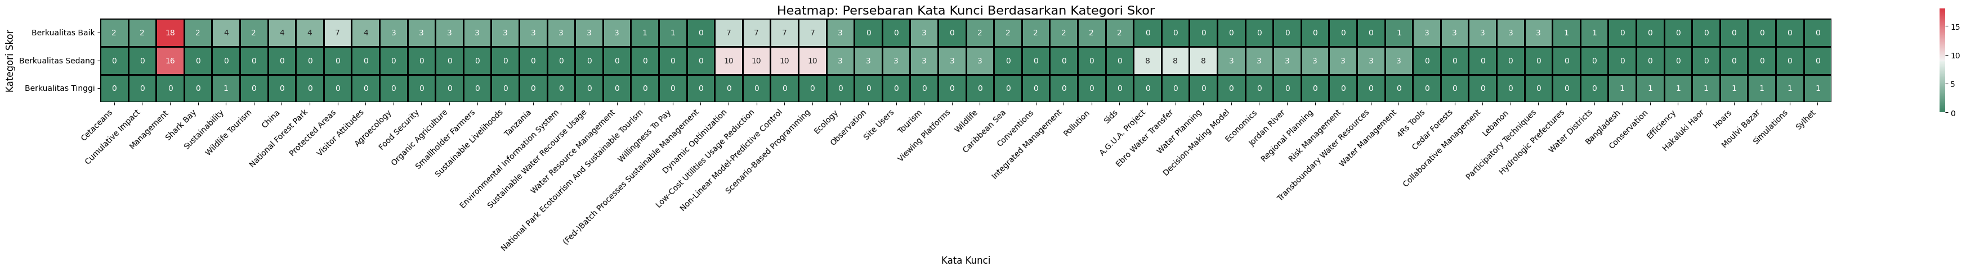
Publication Clustering on 2008
Notes:
PDB/GDP dihitung dalam satuan miliar dolar AS dengan menggunakan harga konstan tahun 2012

Slide 20
Publication Clustering on 2008
Notes:
PDB/GDP dihitung dalam satuan miliar dolar AS dengan menggunakan harga konstan tahun 2012

Slide 21
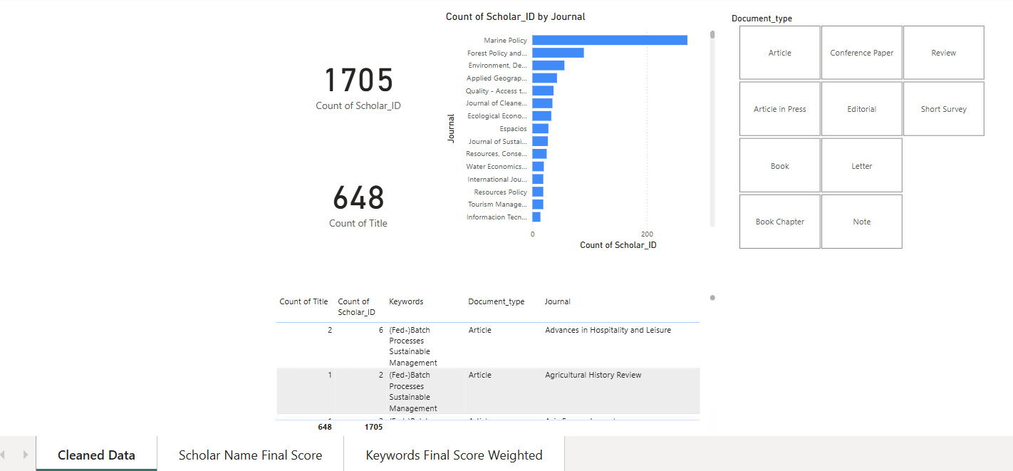
Review Dashboard
Link to dashboard

Slide 22
Conclusions

Slide 23
What I Comprehend
Based on what I have found, here are my insights and outcomes after reviewing the data :
Impact of the 2008 Economic Crisis:
The crisis affected journal quality distribution, with a shift towards high-quality journals post-2008.
Role of Good-Quality Journals:
Good-quality journals remained the backbone of scientific publications, despite a decline in 2008.
Consistency of Medium-Quality Journals:
This category showed fluctuating dynamics, reflecting the need to balance quantity and quality (possibly due to accessibility or relevance).
Notes:
1. Dampak Krisis Ekonomi 2008:
Krisis ekonomi memengaruhi distribusi kualitas jurnal, dengan peningkatan fokus pada jurnal berkualitas tinggi setelah tahun tersebut.
2. Peran Jurnal Berkualitas Baik:
Jurnal berkualitas baik tetap menjadi tulang punggung publikasi ilmiah, meskipun sempat menurun pada 2008.
3. Konsistensi Jurnal Berkualitas Sedang:
Kategori ini menunjukkan dinamika yang fluktuatif, mencerminkan kebutuhan untuk menyeimbangkan kuantitas dan kualitas(mungkin karena aksesibilitas atau relevansinya dengan kebutuhan umum).

Slide 24
References:
https://www.kaggle.com/datasets/saurabhshahane/sustainable-management-publication
https://www.elsevier.com/solutions/scopus/how-scopus-works/content
https://clarivate.com/webofsciencegroup/solutions/webofscience-core-collection/journal-selection-process/
https://sinta.kemdikbud.go.id/
Hirsch, J. E. (2005). "An index to quantify an individual’s scientific research output." Proceedings of the National Academy of Sciences, 102(46), 16569–16572.
Bornmann, L., & Daniel, H. D. (2008). "What do citation counts measure? A review of studies on citing behavior." Journal of Documentation, 64(1), 45–80.
Zupic, I., & Čater, T. (2015). "Bibliometric methods in management and organization." Organizational Research Methods, 18(3), 429–472.
Small, H. (1973). "Co-citation in the scientific literature: A new measure of the relationship between two documents." Journal of the American Society for Information Science, 24(4), 265–269.
Glänzel, W., & Schubert, A. (2004). "Analyzing scientific networks through co-authorship." Handbook of Quantitative Science and Technology Research, 257–276.
Katz, J. S., & Martin, B. R. (1997). "What is research collaboration?" Research Policy, 26(1), 1–18.
Moed, H. F. (2005). Citation Analysis in Research Evaluation. Springer.
van Raan, A. F. J. (2005). "Fatal attraction: Conceptual and methodological problems in the ranking of universities by bibliometric methods." Scientometrics, 62(1), 133–143.

Slide 25
Thank You

